Slide 1

Trees, Forests, Bagging
and Boosting
Topic 11

Slide 2
SQUAD 15
Trees, Forests, Bagging
and Boosting
Tree
Bagging
Forests
Boosting

Slide 3
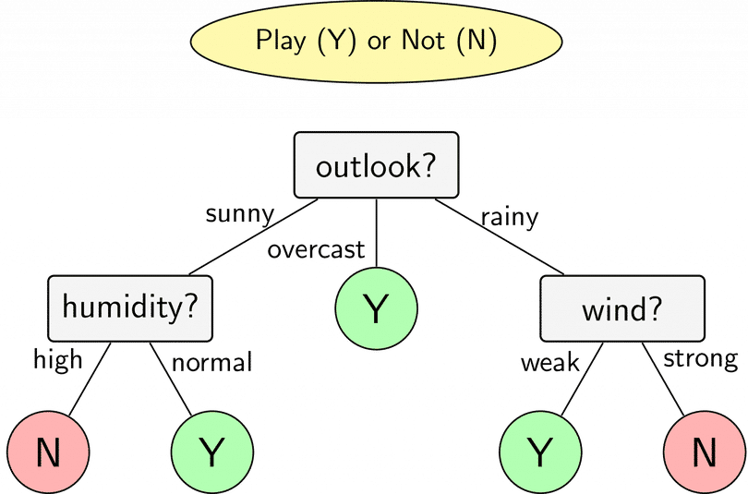
/I
/Tree

Slide 4
/Tree
Overview
/01
Definition
Goal
Algorithm
SQUAD 15

Slide 5
/Tree
Overview
/01
Definition
Decision Trees are a non-parametric supervised learning method used for classification and regression.
Goal
Algorithm
SQUAD 15

Slide 6
/Tree
Overview
/01
Definition
Goal
Create a model that predicts the value of a target variable by learning simple decision rules inferred from the data features.
Algorithm
SQUAD 15

Slide 7
/Tree
Overview
/01
Definition
Goal
Algorithm
ID3(Iterative Dichotomiser 3) leverages entropy and information gain as metrics to evaluate candidate splits.
C4.5 use information gain or gain ratios to evaluate split points within the decision trees. C4.5 is an extension of ID3 Algorithm.
CART (classification and regression trees) utilizes Gini impurity to identify the ideal attribute to split on.
SQUAD 15

Slide 8
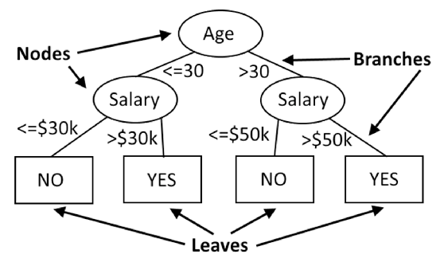
/Tree
Building a Decision Tree
/02
Decision Tree consists of many nodes and branches, so we need to choose the right attribute at each node.
Information Gain
Gini Impurity
SQUAD 15

Slide 9
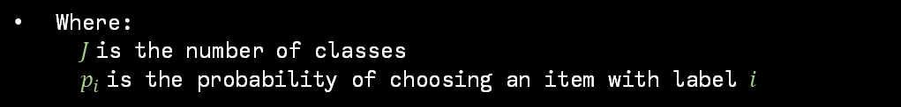
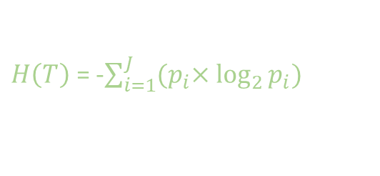
/Tree
/Information Gain(ID3)
Information gain is based on the concept of entropy and information content from information theory, where Entropy is defined as below:
$H\left(T\right)$ = -$\sum_{i=1}^{J}{{(p}_{i}×\log_{2}{p_{i})}}$
Where:
$J$is the number of classes
$p_{i}$is the probability of choosing an item with label $i$
SQUAD 15

Slide 10
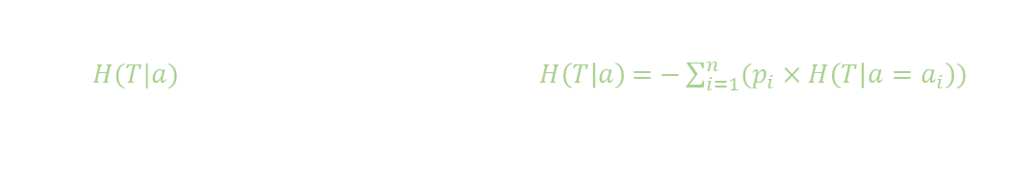
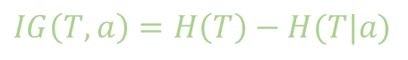
/Tree
/Information Gain(ID3)
Information Gain will be:
$IG\left(T,a\right)=H\left(T\right)−H(T|a)$
Where:
$H(T|a)$ is the entropy of children node: $H\left(T | a\right)\text{ = −}\sum_{i=1}^{n}{(p_{i}×H\left(T | a=a_{i}\right))}$
SQUAD 15

Slide 11
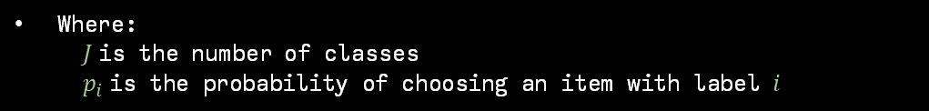
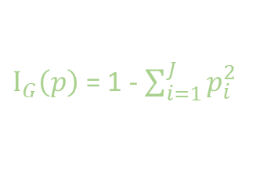
/Tree
/Gini Impurity(CART)
Gini Impurity measures how often a randomly chosen element of a set would be incorrectly labeled if it were labeled randomly and independently according to the distribution of labels in the set. It reaches its minimum (zero) when all cases in the node fall into a single target category.
$Ι_{G}\left(p\right)$ = 1 - $\sum_{i=1}^{J}{p_{i}^{2}}$
Where:
$J$is the number of classes
$p_{i}$is the probability of choosing an item with label $i$
SQUAD 15

Slide 12
/Tree
Advantages and Disadvantages
/03
Advantages
Disadvantages
SQUAD 15

Slide 13
/Tree
Advantages and Disadvantages
/03
Advantages
Decision Trees are simple to understand and interpret
Able to handle both numerical and categorical data
Requires little data preparation
Performs well with large datasets
Disadvantages
SQUAD 15

Slide 14
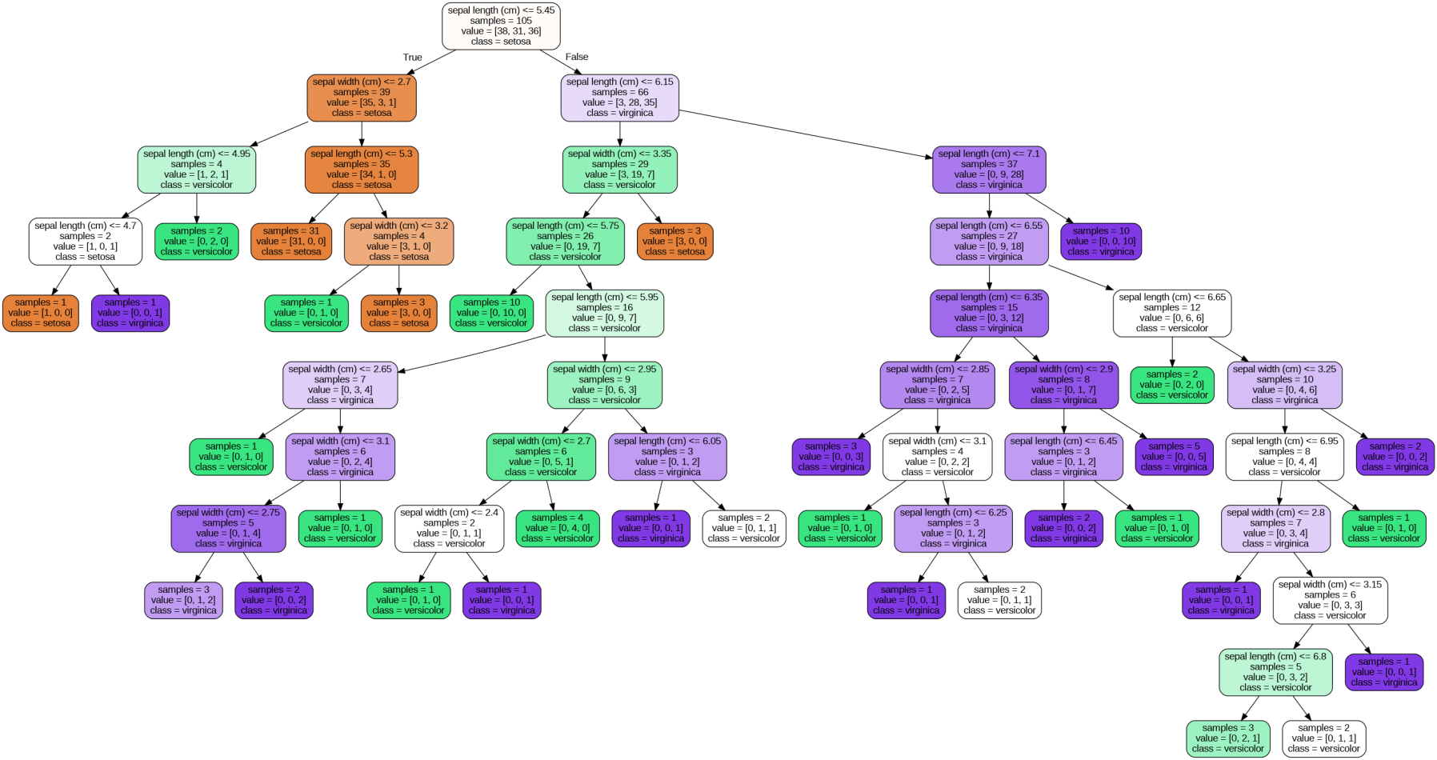
/Tree
Advantages and Disadvantages
/03
Advantages
Disadvantages
One giant flaw of Decision Tree is OVERFITTING, since we can create over-complex trees that do not generalize well from the training data.
SQUAD 15

Slide 15
/Tree
Advantages and Disadvantages
/03
Advantages
Disadvantages
One giant flaw of Decision Tree is OVERFITTING, since we can create over-complex trees that do not generalize well from the training data.
A small change in the training data can result in a large change in the tree and consequently the final predictions.
SQUAD 15

Slide 16
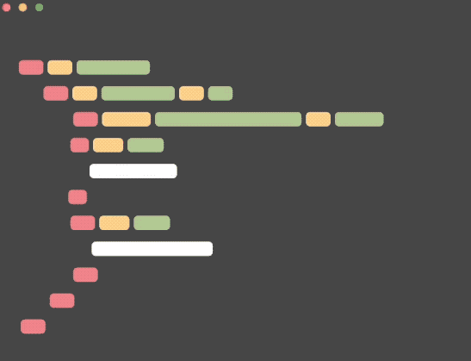
/Tree
Improving a Decision Tree
/04
Pruning: removing unnecessary branches that are non-critical and redundant to classify instances
Max depth: limiting the maximum depth of the Decision Tree
Min sample in a node: having a minimum sample inside a leaf so that the Decision Tree will not be overfitting
SQUAD 15

Slide 17
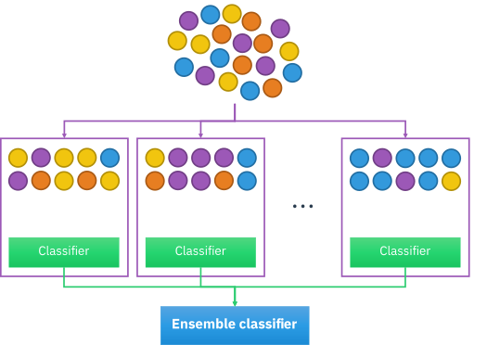
/II
/Bagging

Slide 18
/Bagging
Overview
/01
Definition
Goal
SQUAD 15

Slide 19
/Bagging
Overview
/01
Definition
Bagging (Bootstrap Aggregating) is an ensemble learning method in machine learning. It combines multiple prediction models to create a final prediction. Instead of relying on a single model, Bagging generates independent sub-models and aggregates their predictions to enhance accuracy.
SQUAD 15
Goal

Slide 20
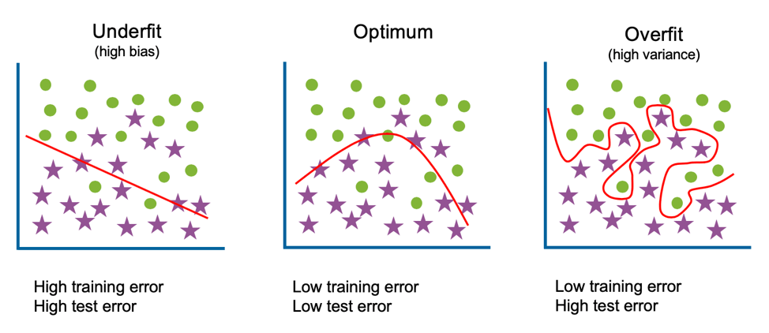
/Bagging
Overview
/01
Definition
Goal
Reduce overfitting, a common issue in machine learning where a model becomes overly complex and struggles to generalize well to new data. It also enhances model accuracy by amalgamating information from various independent sub-models, simultaneously reducing variance among these sub-models.
SQUAD 15

Slide 21
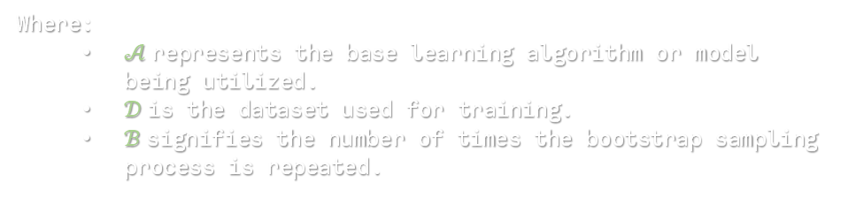
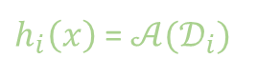
/Bagging
Algorithm
/02
Bagging($𝒜,𝒟,ℬ$) denotes the Bagging procedure:
$h_{i}\left(x\right)$ = $𝒜(𝒟_{i})$
Where:
$𝒜$represents the base learning algorithm or model being utilized.
$𝒟$is the dataset used for training.
$ℬ$signifies the number of times the bootstrap sampling process is repeated.
SQUAD 15

Slide 22
/Bagging
Bootstrap Sampling
/a
Define Bootstrap Sampling: Explain how it involves randomly sampling data with replacement to create multiple new datasets.
Example: We have a dataset of 10 data points: [1, 2, 3, 4, 5, 6, 7, 8, 9, 10]:
First Iteration: Randomly select 10 data points from the original dataset with replacement: [3, 8, 1, 3, 9, 2, 5, 9, 6, 3]
Second Iteration: Again, randomly select another set of 10 data points from the original dataset with replacement : [5, 6, 10, 4, 2, 7, 1, 10, 3, 8]
Third Iteration: Again, randomly select another set of 10 data points from the original dataset with replacement : [4, 6, 2, 4, 2, 1, 1, 7, 3, 9]
SQUAD 15

Slide 23
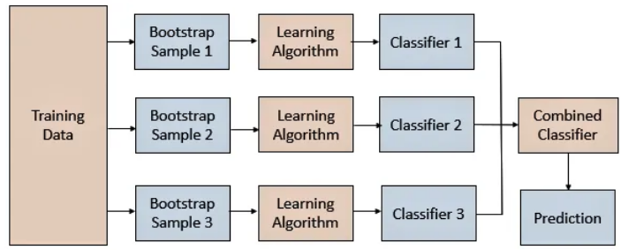
/Bagging
Parallel training
/b
Parallel training in bagging refers to the process of independently and simultaneously training multiple sub-models using the bootstrap samples.
After creating subsets through random bootstrap sampling, each subset represents a different training dataset. The training of these subsets is performed independently, meaning that the sub-models are trained simultaneously and are not dependent on each other.
In this process, each subset is used to train a separate model using weak or base learners. For example, each subset can be used to train a decision tree.
SQUAD 15

Slide 24
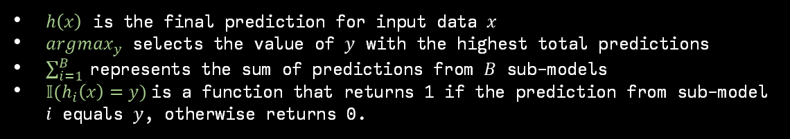
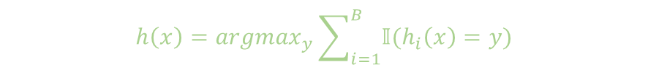
/Bagging
Aggregation
/c
Finally, depending on the task (i.e. regression or classification), an average or a majority of the predictions are taken to compute a more accurate estimate. For classification problems, the class with the highest majority of votes is accepted; this is known as hard voting or majority voting
$$h\left(x\right)={argmax}_{y}\sum_{i=1}^{B}{𝕀(h_{i}\left(x\right)=y)}$$
Where:
$h\left(x\right)$ is the final prediction for input data $x$
${argmax}_{y}$ selects the value of $y$ with the highest total predictions
$\sum_{i=1}^{B}{ }$represents the sum of predictions from $B$ sub-models
$𝕀(h_{i}\left(x\right)=y)$is a function that returns 1 if the prediction from sub-model $i$ equals $y$, otherwise returns 0.
SQUAD 15

Slide 25
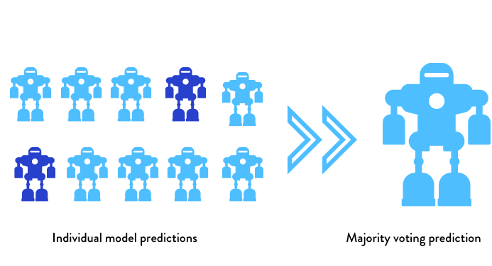
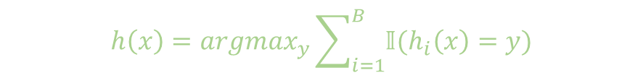
/Bagging
Aggregation
/c
$$h\left(x\right)={argmax}_{y}\sum_{i=1}^{B}{𝕀(h_{i}\left(x\right)=y)}$$
SQUAD 15

Slide 26
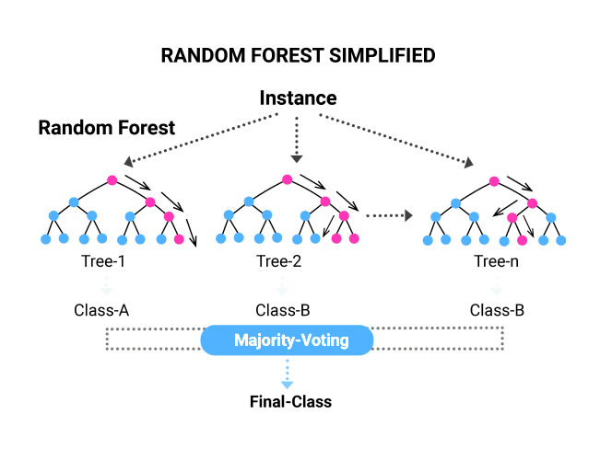
/III
/Random Forests

Slide 27
/Random Forests
Overview
/01
Definition
Goal
SQUAD 15

Slide 28
/Random Forests
Overview
/01
Definition
Random forests are an enhanced version of bagging in ensemble learning. They leverage random feature selection during the construction of decision trees, which distinguishes them from traditional bagging methods. At each node creation within a tree, only a random subset of features is considered to determine the best possible split. This innovation aims to increase diversity among the decision trees and, consequently, enhance model performance
Goal
SQUAD 15

Slide 29
/Random Forests
Overview
/01
Definition
Goal
Random Forests focuses not only on reducing overfitting—a common issue in machine learning where a model becomes overly complex and struggles to generalize well to new data—but also on improving predictive performance by fostering greater diversity among decision trees. This approach effectively reduces variance and overfitting more efficiently, thereby enhancing the model's generalization and accuracy on new data
SQUAD 15

Slide 30
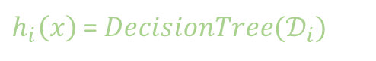
/Random Forests
Algorithm
/02
Random Forests($𝒟,ℬ$) denotes the Random Forests procedure:
$h_{i}\left(x\right)$ = $DecisionTree(𝒟_{i})$
Randomly select $m=\sqrt{p}$​ attributes from $A_{1},A_{2},A_{3}, A_{4}…A_{p}$​.
Attribute Selection: Choose an attribute to split from these $m$ attributes.
SQUAD 15

Slide 31
/Random Forests
Out-of-bag
/03
In a Random Forest comprised of, let's say, 100 decision trees:
Each tree is trained on a bootstrapped sample, meaning it randomly selects approximately two-thirds (2/3) of the total data for training.
Consequently, the remaining one-third (1/3) of the data that wasn't used in training becomes the "out-of-bag" (OOB) samples for that specific tree.
SQUAD 15

Slide 32
/Random Forests
Out-of-bag
/03
Chest pain | Good Blood Circ. | Blooked Arteries | Weight | Heart Disease
No | No | No | 125 | No
Yes | Yes | Yes | 180 | Yes
Yes | Yes | No | 210 | No
Yes | No | Yes | 167 | Yes
Chest pain | Good Blood Circ. | Blooked Arteries | Weight | Heart Disease
Yes | Yes | Yes | 180 | Yes
No | No | No | 125 | No
Yes | No | Yes | 167 | Yes
Yes | No | Yes | 167 | Yes
Training Dataset D
Boostrapped Dataset D₁
SQUAD 15

Slide 33
/Random Forests
Out-of-bag
/03
The main goal of Out-of-Bag (OOB) Error is to utilize "out-of-bag" samples (data not selected for training) to evaluate the model's generalization ability on new data it hasn't previously encountered. This is particularly useful as it assesses performance without requiring a separate test dataset, saving time and resources.
SQUAD 15

Slide 34

/IV
/Boosting

Slide 35
/IV
/Boosting

Slide 36
/Boosting
Overview
/01
Boosting is an ensemble modeling technique that attempts to build a strong classifier from the number of weak classifiers. It is done by building a model by using weak models in series. Firstly, a model is built from the training data. Then the second model is built which tries to correct the errors present in the first model. This procedure is continued and models are added until either the complete training data set is predicted correctly or the maximum number of models are added.
SQUAD 15

Slide 37
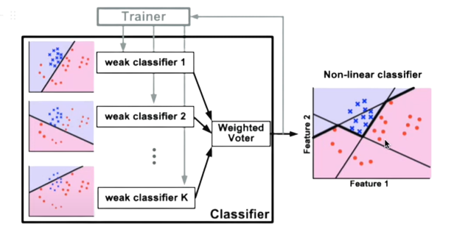
/Boosting
Overview
/01
Boosting
Trainer
weak classifier 1
Non-linear classifier
weak classifier 2
Feature 2
Weighted voted
weak classifier 3
Feature 1
Classifier
SQUAD 15

Slide 38
/Boosting
Additive Boosting
/02
Additive Boosting (ℱ, 𝒟, ℓ)
SQUAD 15

Slide 39
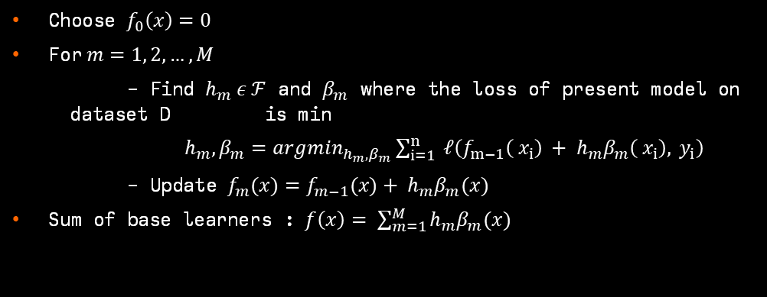
/Boosting
Additive Boosting
/02
Additive Boosting (ℱ, 𝒟, ℓ)
Choose $f_{0}\left(x\right)=0$
For$m=1, 2,…, M$
- Find $h_{m} ε ℱ$ and $β_{m}$ where the loss of present model on dataset D is min
$h_{m},β_{m}={argmin}_{h_{m},β_{m}}\sum_{i=1}^{n}{ ℓ\left(f_{m−1}\left( x_{i}\right) + h_{m}β_{m}\left( x_{i}\right), y_{i}\right)}$
- Update $f_{m}(x)=f_{m−1}(x)+ h_{m}β_{m}(x)$
Sum of base learners : $f\left(x\right)= \sum_{m=1}^{M}{h_{m}β_{m}(x)}$
SQUAD 15

Slide 40
/Boosting
Additive Boosting
/02
/AdaBoost
AdaBoost
binary classification $y ε \left\{ −1, +1\right\} and ℓ\left(\hat{y}, y\right)= e^{−\hat{y}y}$
SQUAD 15

Slide 41
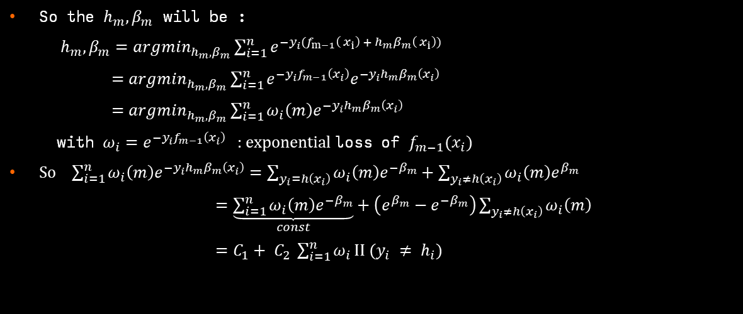
/Boosting
Additive Boosting
/02
/AdaBoost
AdaBoost
binary classification $y ε \left\{ −1, +1\right\} and ℓ\left(\hat{y}, y\right)= e^{−\hat{y}y}$
So the $h_{m},β_{m}$ will be :
$h_{m},β_{m}={argmin}_{h_{m},β_{m}}\sum_{i=1}^{n}{e^{−y_{i}(f_{m−1}\left( x_{i}\right) + h_{m}β_{m}\left( x_{i}\right))}}$
$=argmin_{h_{m},β_{m}}\sum_{i=1}^{n}{e^{−y_{i}f_{m−1}\left(x_{i}\right)}e^{−y_{i}h_{m}β_{m}\left(x_{i}\right)}}$
$=argmin_{h_{m},β_{m}}\sum_{i=1}^{n}{ω_{i}\left(m\right)e^{−y_{i}h_{m}β_{m}\left(x_{i}\right)}}$
with $ω_{i}=e^{−y_{i}f_{m−1}\left(x_{i}\right)}$ : exponential loss of $f_{m−1}(x_{i})$
So $\sum_{i=1}^{n}{ω_{i}\left(m\right)e^{−y_{i}h_{m}β_{m}\left(x_{i}\right)}}=\sum_{y_{i}=h\left(x_{i}\right)}{ω_{i}\left(m\right)e^{−β_{m}}}+\sum_{y_{i}≠h\left(x_{i}\right)}{ω_{i}\left(m\right)e^{β_{m}}}$
$=\underset{const}{\underbrace{\sum_{i=1}^{n}{ω_{i}\left(m\right)e^{−β_{m}}}}}+\left(e^{β_{m}}−e^{−β_{m}}\right)\sum_{y_{i}≠h\left(x_{i}\right)}{ω_{i}\left(m\right)}$
$=C_{1}+ C_{2} \sum_{i=1}^{n}{ω_{i}}II (y_{i} ≠ h_{i})$
SQUAD 15

Slide 42
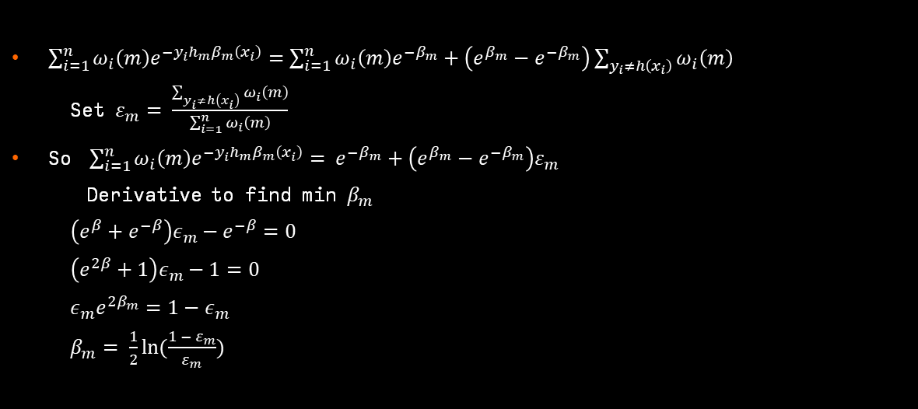
/Boosting
Additive Boosting
/02
/AdaBoost
AdaBoost
binary classification $y ε \left\{ −1, +1\right\} and ℓ\left(\hat{y}, y\right)= e^{−\hat{y}y}$
$\sum_{i=1}^{n}{ω_{i}\left(m\right)e^{−y_{i}h_{m}β_{m}\left(x_{i}\right)}}=\sum_{i=1}^{n}{ω_{i}\left(m\right)e^{−β_{m}}}+\left(e^{β_{m}}−e^{−β_{m}}\right)\sum_{y_{i}≠h\left(x_{i}\right)}{ω_{i}\left(m\right)}$
Set $ε_{m}= \frac{\sum_{y_{i}≠h\left(x_{i}\right)}{ω_{i}\left(m\right)}}{\sum_{i=1}^{n}{ω_{i}\left(m\right)}}$
So $\sum_{i=1}^{n}{ω_{i}\left(m\right)e^{−y_{i}h_{m}β_{m}\left(x_{i}\right)}}= e^{−β_{m}}+\left(e^{β_{m}}−e^{−β_{m}}\right)ε_{m}$
Derivative to find min $β_{m}$
$\left(e^{β}+e^{−β}\right)ε_{m}−e^{−β}=0$
$\left(e^{2β}+1\right)ε_{m}−1=0$
$ε_{m}e^{2β_{m}}=1−ε_{m}$
$β_{m}= \frac{1}{2}ln⁡(\frac{1 − ε_{m}}{ε_{m}})$
SQUAD 15

Slide 43
/Boosting
Additive Boosting
/02
/AdaBoost
AdaBoost
binary classification $y ε \left\{ −1, +1\right\} and ℓ\left(\hat{y}, y\right)= e^{−\hat{y}y}$
$\sum_{i=1}^{n}{ω_{i}\left(m\right)e^{−y_{i}h_{m}β_{m}\left(x_{i}\right)}}=\sum_{i=1}^{n}{ω_{i}\left(m\right)e^{−β_{m}}}+\left(e^{β_{m}}−e^{−β_{m}}\right)\sum_{y_{i}≠h\left(x_{i}\right)}{ω_{i}\left(m\right)}$
Set $ε_{m}= \frac{\sum_{y_{i}≠h\left(x_{i}\right)}{ω_{i}\left(m\right)}}{\sum_{i=1}^{n}{ω_{i}\left(m\right)}}$
So $\sum_{i=1}^{n}{ω_{i}\left(m\right)e^{−y_{i}h_{m}β_{m}\left(x_{i}\right)}}= e^{−β_{m}}+\left(e^{β_{m}}−e^{−β_{m}}\right)ε_{m}$
Derivative to find min $β_{m}$
$\left(e^{β}+e^{−β}\right)ε_{m}−e^{−β}=0$
$\left(e^{2β}+1\right)ε_{m}−1=0$
$ε_{m}e^{2β_{m}}=1−ε_{m}$
$β_{m}= \frac{1}{2}ln⁡(\frac{1 − ε_{m}}{ε_{m}})$
SQUAD 15

Slide 44
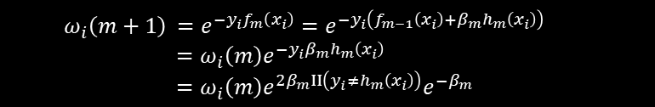
/Boosting
Additive Boosting
/02
/AdaBoost
AdaBoost
binary classification $y ε \left\{ −1, +1\right\} and ℓ\left(\hat{y}, y\right)= e^{−\hat{y}y}$
New weight:
$ω_{i}\left(m+1\right)$ $=e^{−y_{i}f_{m}\left(x_{i}\right)}=e^{−y_{i}\left(f_{m−1}\left(x_{i}\right)+β_{m}h_{m}\left(x_{i}\right)\right)}$
$=ω_{i}\left(m\right)e^{−y_{i}β_{m}h_{m}\left(x_{i}\right)}$
$=ω_{i}\left(m\right)e^{2β_{m}II\left(y_{i}≠h_{m}\left(x_{i}\right)\right)}e^{−β_{m}}$
SQUAD 15

Slide 45
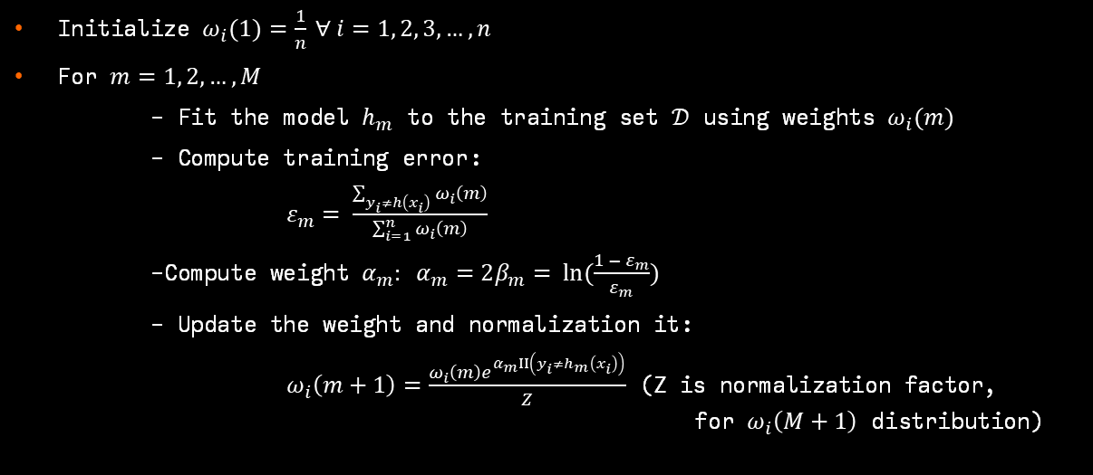
/Boosting
Additive Boosting
/02
/AdaBoost
AdaBoost
($ℱ, 𝒟$)
Initialize $ω_{i}(1)=\frac{1}{n} ∀ i=1, 2, 3, …, n$
For $m=1, 2,…, M$
- Fit the model $h_{m}$ to the training set $𝒟$ using weights $ω_{i}(m)$
- Compute training error:
$ε_{m}= \frac{\sum_{y_{i}≠h\left(x_{i}\right)}{ω_{i}\left(m\right)}}{\sum_{i=1}^{n}{ω_{i}\left(m\right)}}$
-Compute weight $α_{m}: α_{m}=2β_{m}= ln⁡(\frac{1 − ε_{m}}{ε_{m}})$
- Update the weight and normalization it:
$ω_{i}\left(m+1\right)=\frac{ω_{i}\left(m\right)e^{α_{m}II\left(y_{i}≠h_{m}\left(x_{i}\right)\right)}}{Z}$ (Z is normalization factor, for $ω_{i}\left(M+1\right)$ distribution)
SQUAD 15

Slide 46
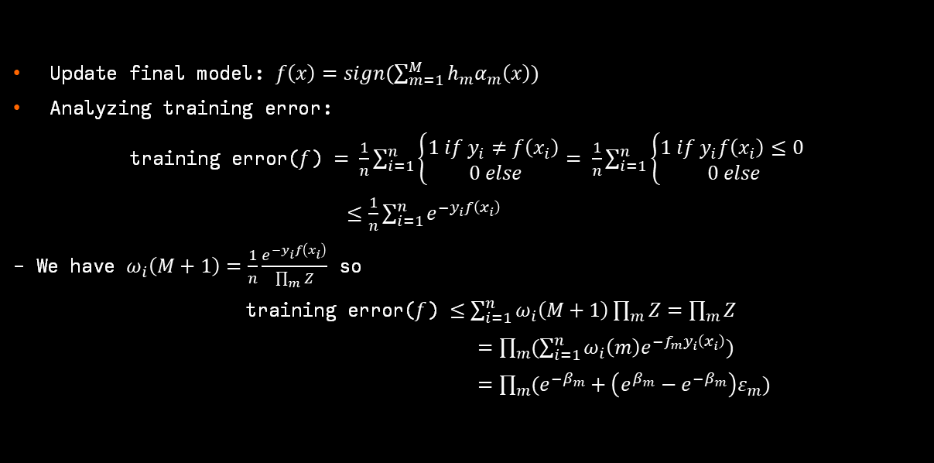
/Boosting
Additive Boosting
/02
/AdaBoost
AdaBoost
($ℱ, 𝒟$)
Update final model: $f\left(x\right)=sign(\sum_{m=1}^{M}{h_{m}α_{m}\left(x\right)})$
Analyzing training error:
training error($f$) $= \frac{1}{n}\sum_{i=1}^{n}{\left\{\begin{aligned}1 if y_{i}≠f\left(x_{i}\right) \\ 0 else\end{aligned}\right.}= \frac{1}{n}\sum_{i=1}^{n}{\left\{\begin{aligned}1 if y_{i}f\left(x_{i}\right)≤0 \\ 0 else\end{aligned}\right.}$
$≤\frac{1}{n}\sum_{i=1}^{n}{e^{−y_{i}f\left(x_{i}\right)}}$
- We have $ω_{i}\left(M+1\right)=\frac{1}{n}\frac{e^{−y_{i}f\left(x_{i}\right)}}{\prod_{m}{Z}}$ so
training error($f$) $≤\sum_{i=1}^{n}{ω_{i}\left(M+1\right)}\prod_{m}{Z}=\prod_{m}{Z}$
$=\prod_{m}{(\sum_{i=1}^{n}{ω_{i}\left(m\right)e^{−f_{m}y_{i}\left(x_{i}\right)})}}$
$=\prod_{m}{(e^{−β_{m}}+\left(e^{β_{m}}−e^{−β_{m}}\right)ε_{m})}$
SQUAD 15

Slide 47

/Boosting
Additive Boosting
/02
/AdaBoost
AdaBoost
($ℱ, 𝒟$)
Analyzing training error:
training error($f$) $≤\prod_{m}{(e^{−β_{m}}+\left(e^{β_{m}}−e^{−β_{m}}\right)ε_{m})}$
- Set $β_{m}= \frac{1}{2}ln⁡(\frac{1 − ε_{m}}{ε_{m}})$
training error($f$) $≤\prod_{m}{(2\sqrt{ε_{m}(1−ε_{m})})}$
- Set $γ_{m}=\frac{1}{2} −ε_{m}$
training error($f$) $≤\prod_{m}{\left(\sqrt{1−4{γ_{m}}^{2}}\right)} ≤ e^{−2\sum_{m}{{γ_{m}}^{2}}}$
SQUAD 15

Slide 48
/Comparison table
Algorithm | Operation | Model Diversity | Applications
Decision Tree | Constructs decision trees by splitting data based on feature thresholds. This process repeats until a stopping condition is met (tree depth or minimum samples). | Limited diversity, prone to overfitting with sparse data. | Data classification and prediction, suitable for simple structured problems.
Bagging | Utilizes bootstrapping to create multiple data subsets and builds independent trees. Finally, results are combined through majority voting (for classification). | Creates diversity by training multiple models on different data subsets. | Data classification and prediction, effective for large datasets, helps reduce overfitting.
Random Forests | Incorporates randomness during model building by selecting a small number of features at each tree node. Creates multiple independent decision trees and combines them. | Achieves diversity by using randomness in feature and sample selection, reducing overfitting and enhancing stability. | Data classification and prediction, effective for large datasets, reducing overfitting and enhancing stability.
Boosting | Builds models sequentially, with each new model focusing on adjusting data points misclassified by previous models. Models are combined through weighted summation. | Creates diversity by focusing on modifying misclassified data points. | Suitable for high-accuracy prediction problems, reduces bias and variance, but can be prone to overfitting.
SQUAD 15

